Slide 1
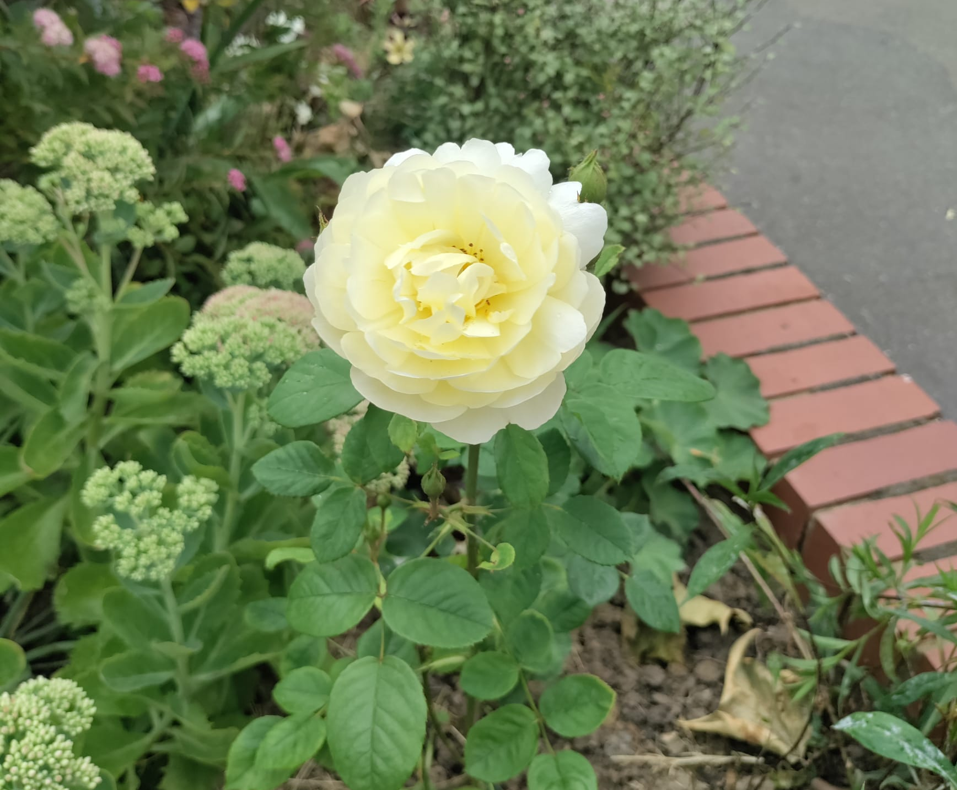
Aldersbrook Medical Centre Garden

Slide 2
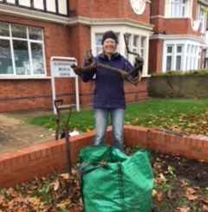
Gill James in existing brick planter

Slide 3
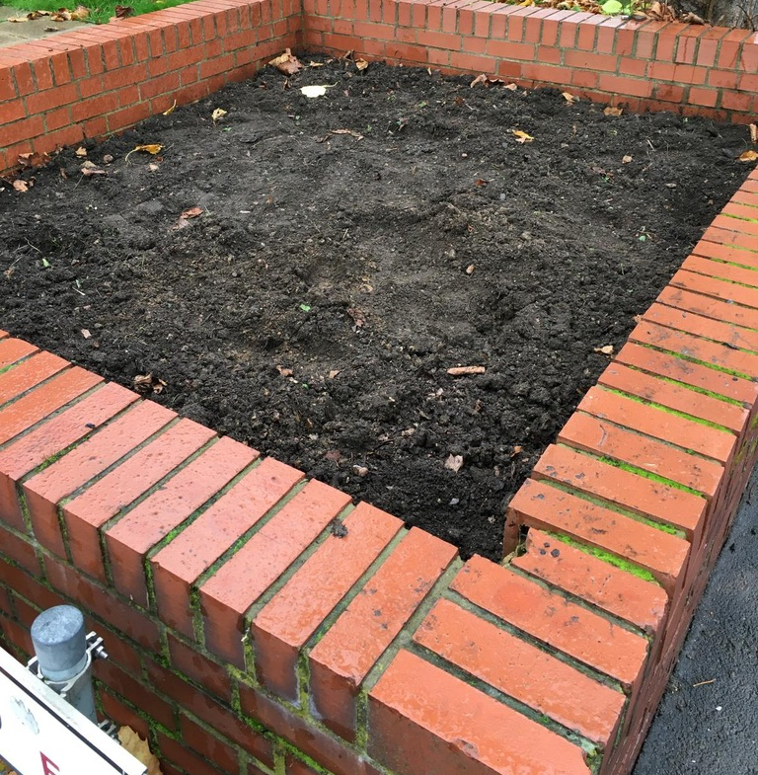
AHS paid for top soil to establish the planting

Slide 4
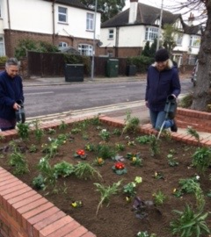
The early stages of planting ……

Slide 5
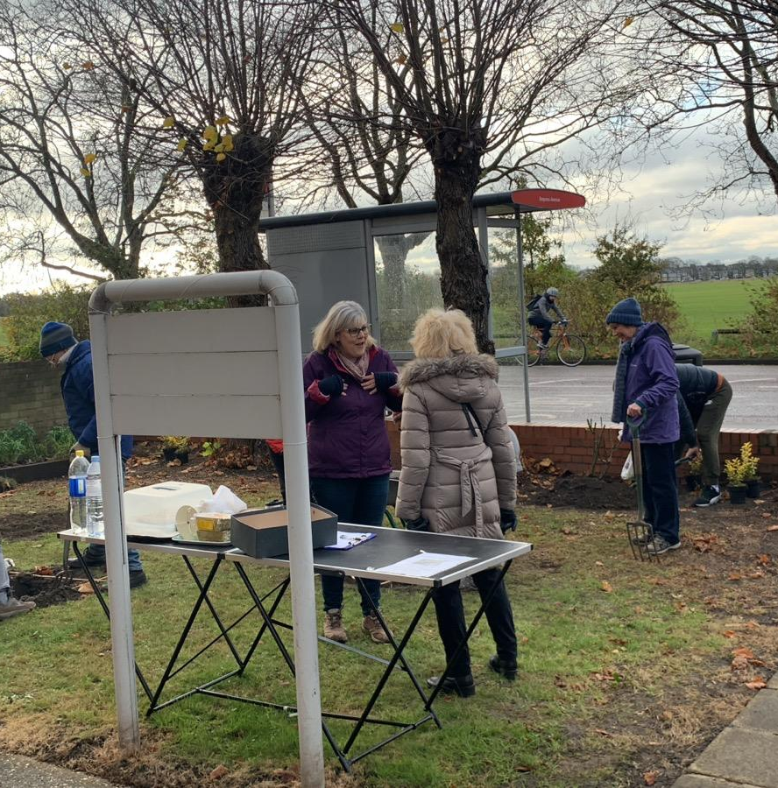
AHS & AMCPPG members working on the garden

Slide 6
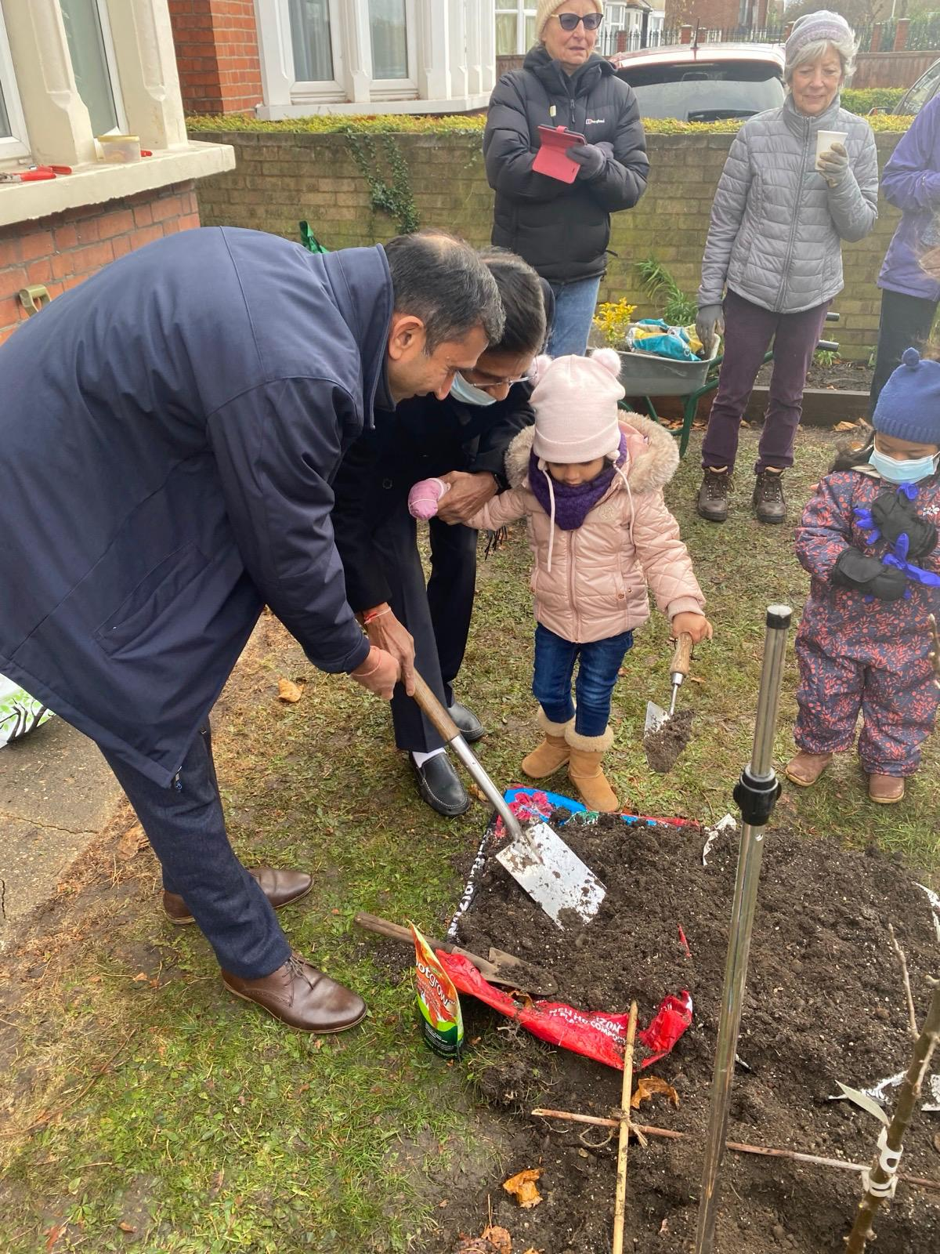

Planting the apple trees with AMC staff, the PPG & AHS members.

Slide 7
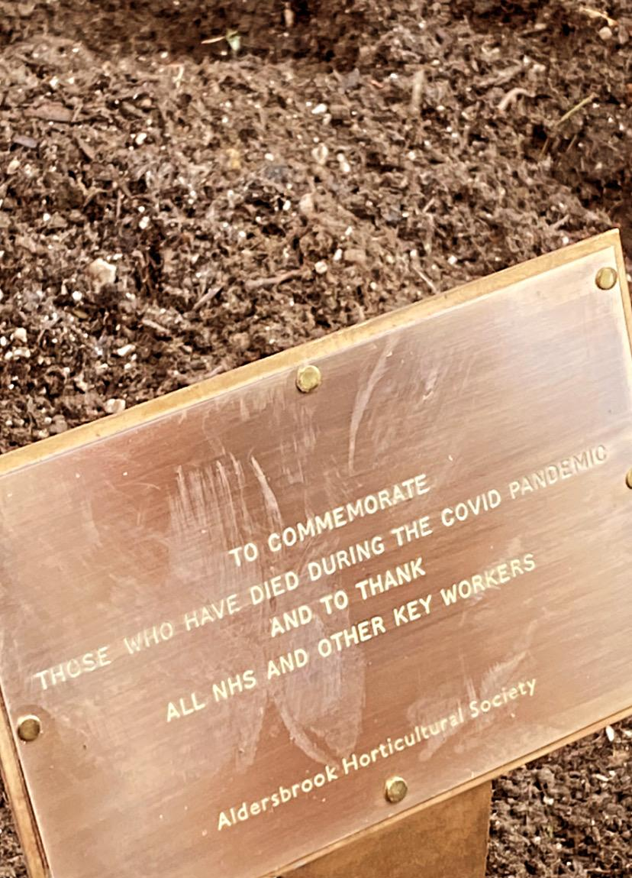
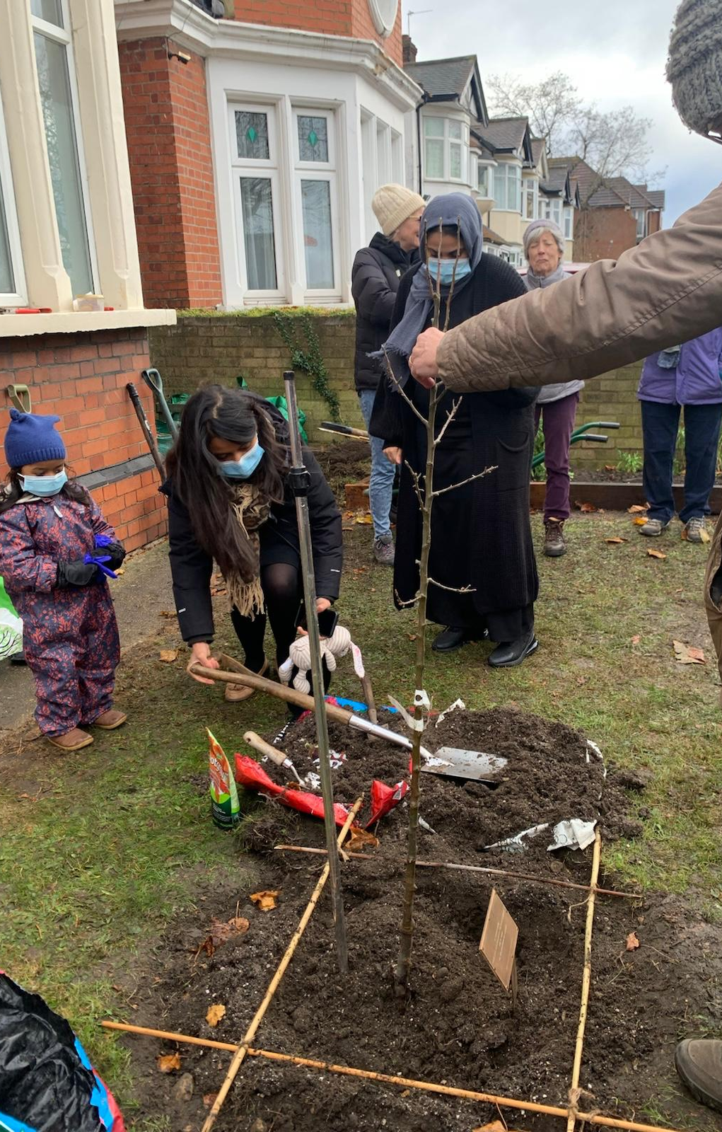
Commemorative plaque

Slide 8
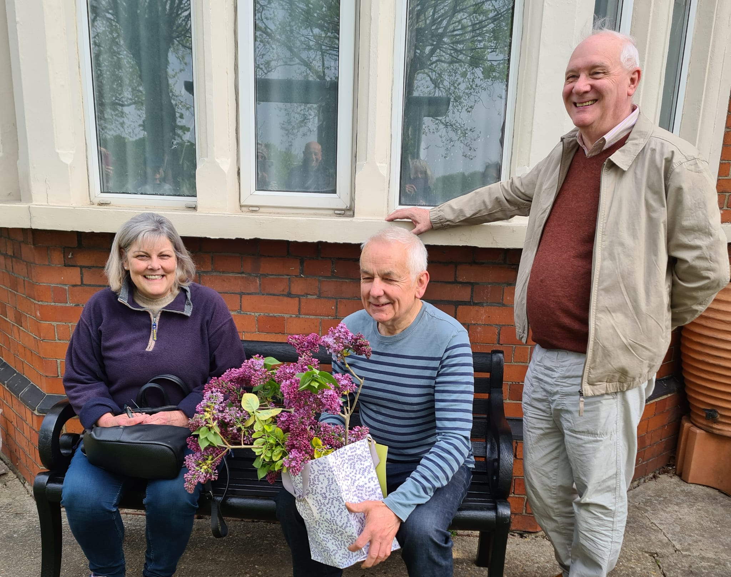
The Bench

Slide 9
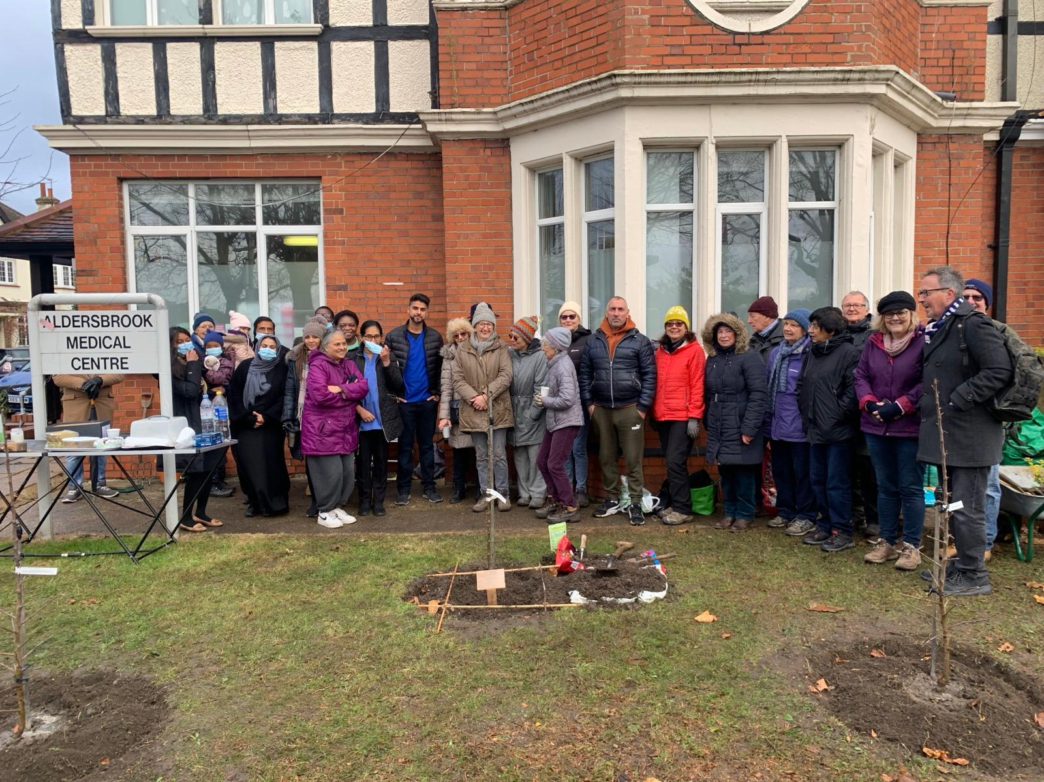
Job done!

Slide 10
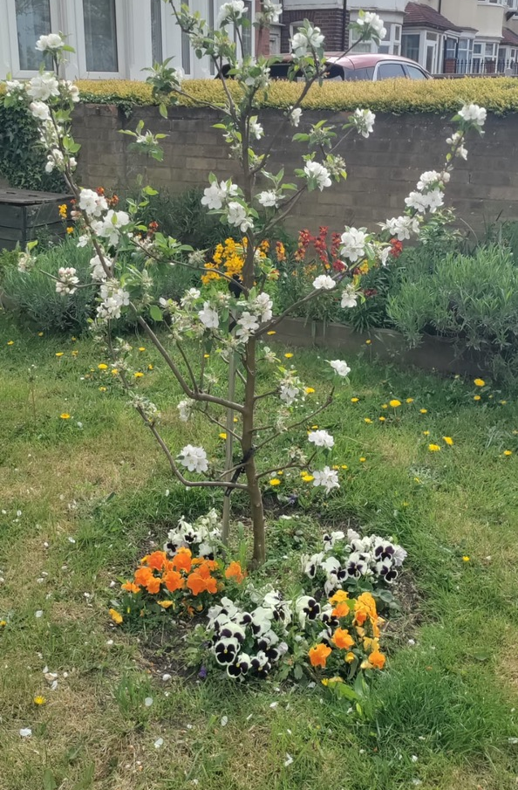
Trees in blossom

Slide 11
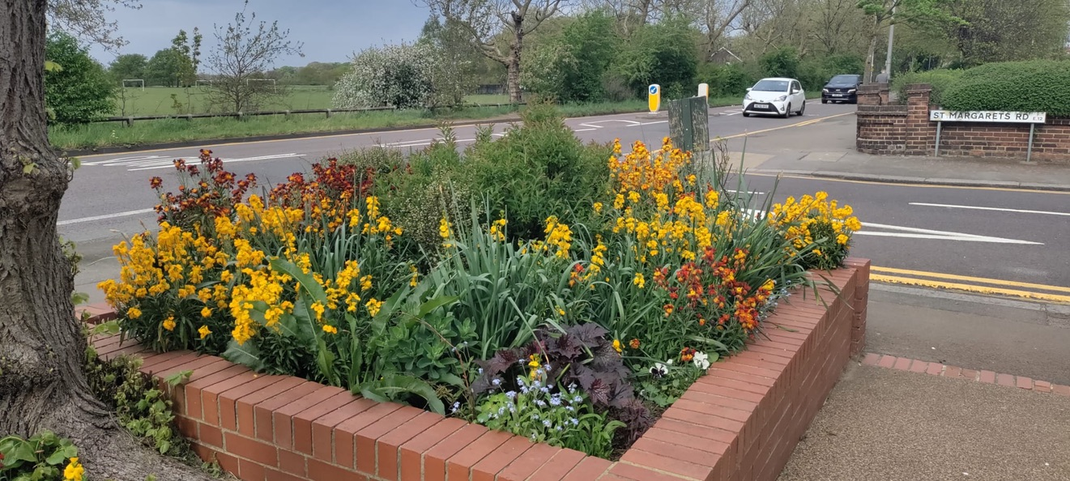
Blooming marvellous

Slide 12
