Slide 1
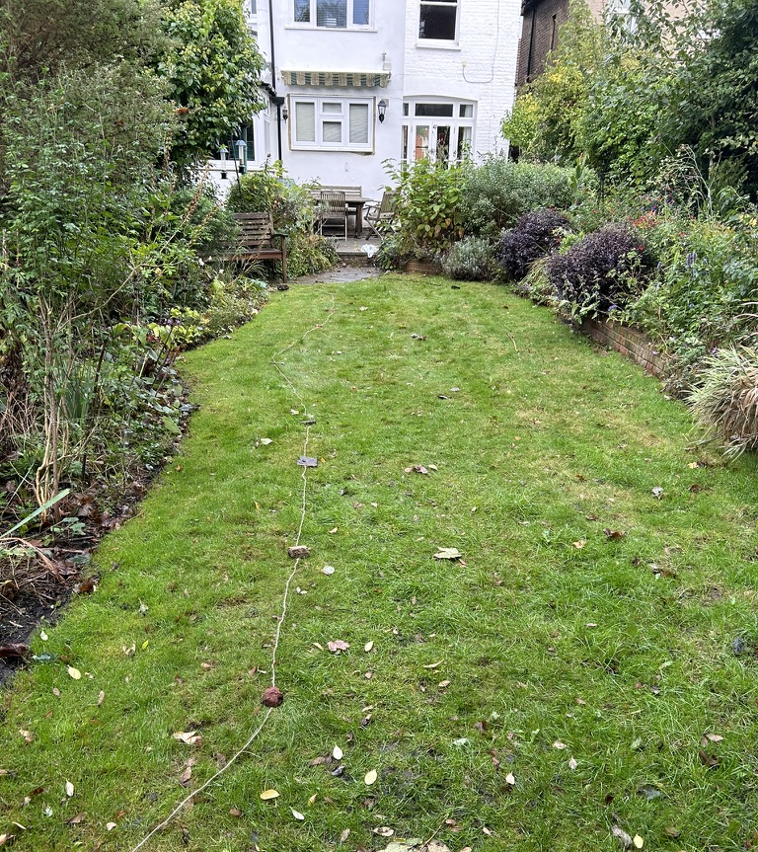
October 2024
Ruth’s garden
Reducing the size of the lawn

Slide 2
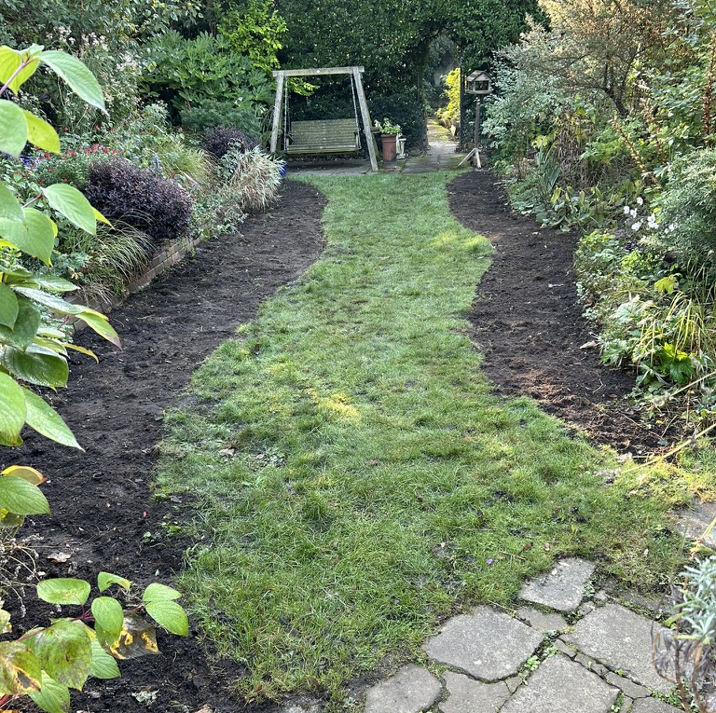
Lawn dug
Giving a grass path down the middle & lots more planting space.

Slide 3
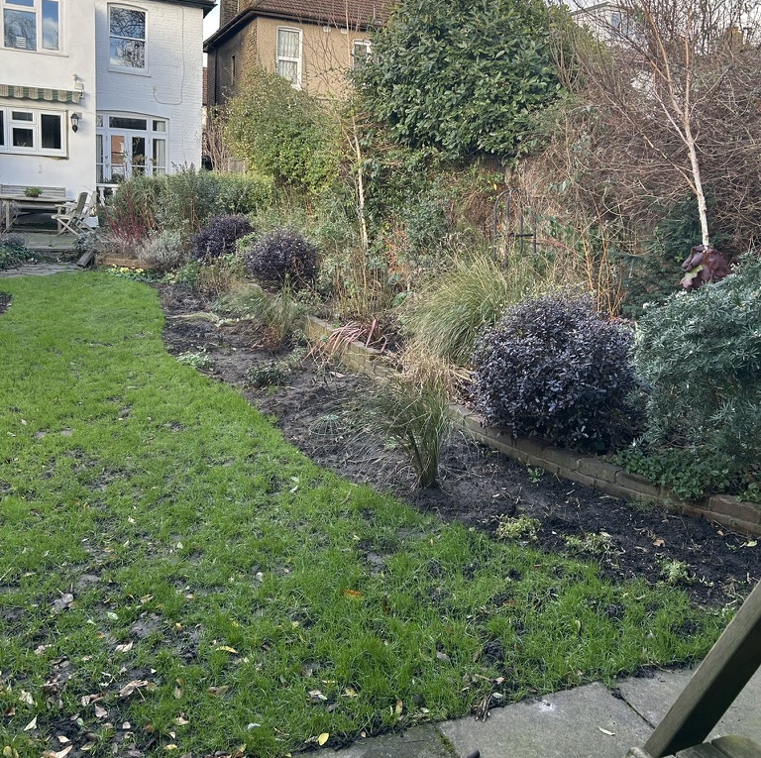
January 2025
Plants added

Slide 4
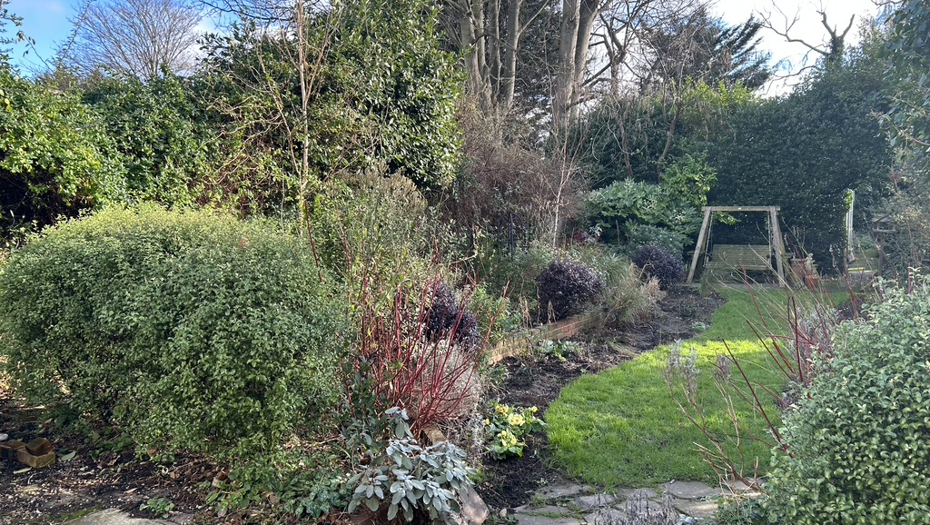

Slide 5
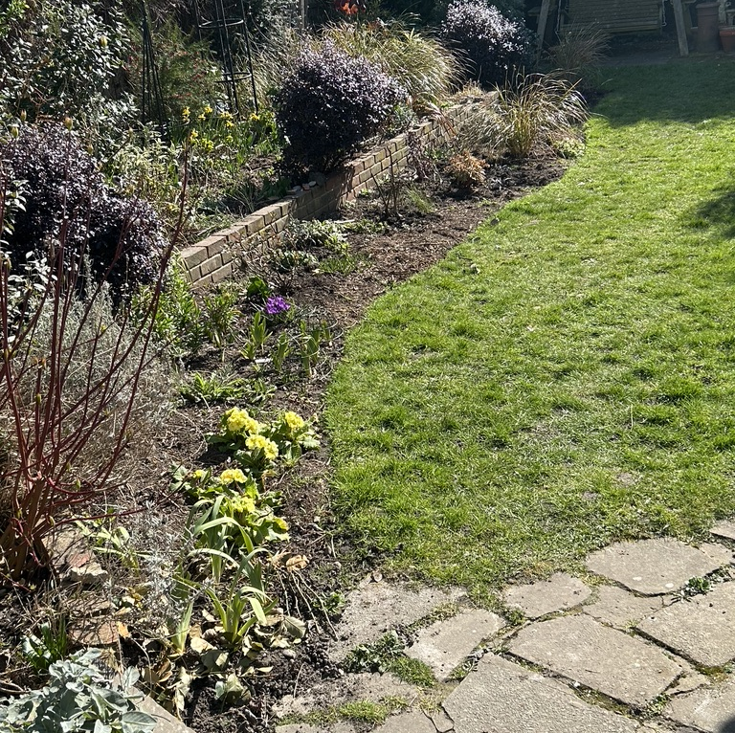
March 2025
More plants ….

Slide 6
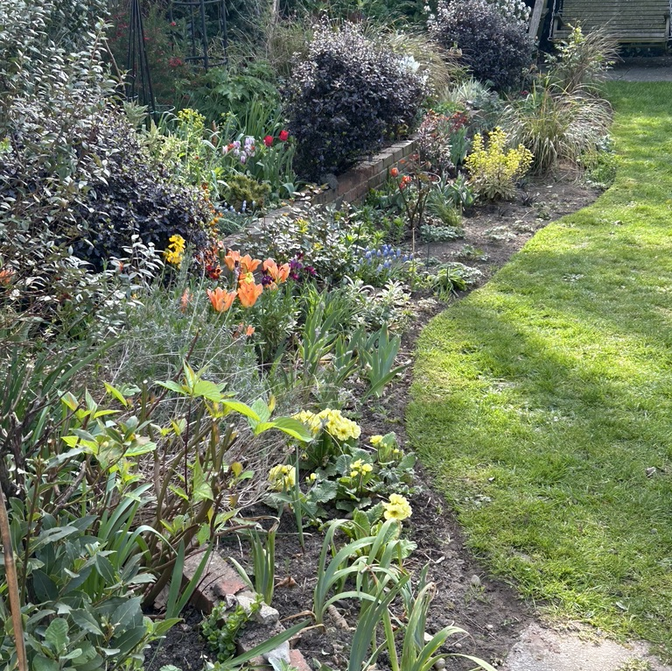
April 2025
Bulbs added

Slide 7
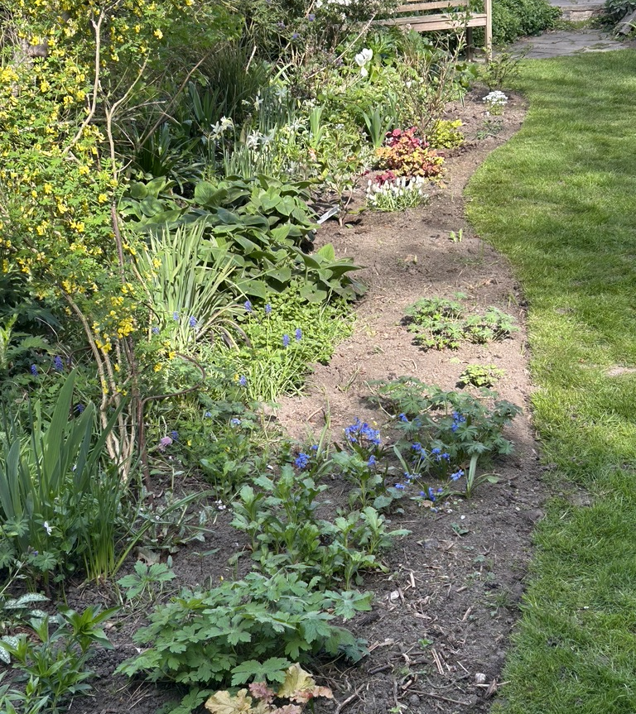
April

Slide 8
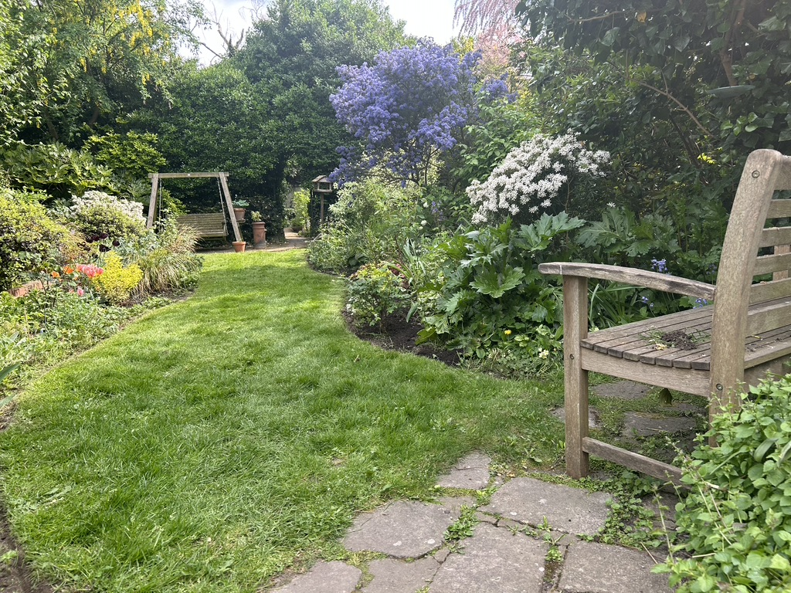
May

Slide 9
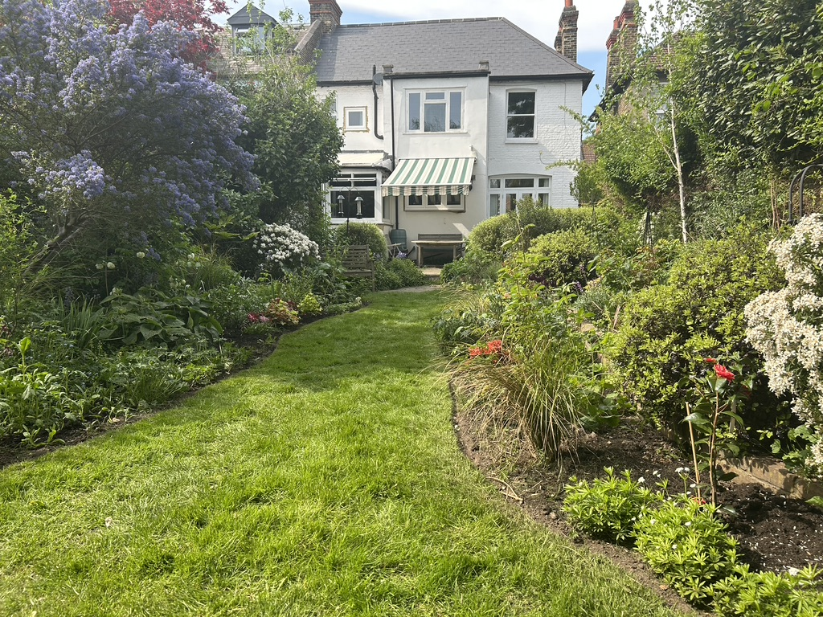
May

